Slide 1
Chapter 1: Investigating human biology

Slide 2
1.1 Studying human biological science
What is human biological science?
Human biological science is the scientific study of humans, both as individuals and as populations, and the study of the interaction between humans and their environment.
It utilises a wide range of fields of study to develop an in-depth knowledge of humans.
Science is a process of inquiry and a body of knowledge. Knowledge is continually increasing as new discoveries are made, and existing knowledge often has to be modified, or even discarded, as new evidence accumulates.

Slide 3
1.1 Studying human biological science
How do scientists investigate?
Literature review
A review of books, scientific journals and the Internet to see what information has already been collected by others.
Observation
Information is gathered using the senses or instruments that enhance the senses, such as a microscope or stethoscope.
Classification
The grouping of organisms based on the similarity of their characteristics; the placement of organisms into groups.
Experimentation
An experiment tests a hypothesis. It must be designed so that the results clearly support or disprove the hypothesis being tested. Only one factor, or variable, is tested at a time.

Slide 4
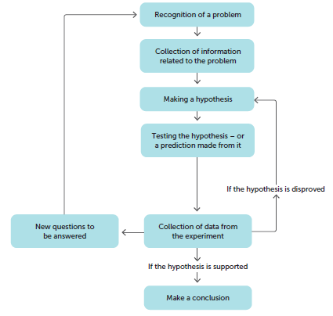
1.2 Scientific method
The scientific method is a process of conducting valid investigations. The precise method will be unique to the particular circumstances, but the underlying pattern of logical thought is similar in all cases.

Slide 5
1.2 Scientific method
Identifying a problem
Scientific investigation begins with a problem. Curiosity about why and how things happen is a characteristic of human nature.
Collecting information
Having defined the problem, the scientist begins to collect information about the problem. This may involve direct observation.
Identifying variables
A variable is any factor that may change during an experiment. In an investigation, variables are classified as either independent, dependent or controlled.
The independent variable is the factor that is being investigated. This means that it is the factor that is deliberately changed to determine how it affects the results (also called the experimental variable or the manipulated variable).
The dependent variable is the factor that changes due to the changes made to the independent variable (also called the responding variable).
Controlled variables are the factors that are kept the same for both the control and experimental groups in an experiment.

Slide 6
1.2 Scientific method
Developing a hypothesis
After collecting information related to the problem, the scientist can then suggest an explanation for the observations. This is called a hypothesis: a statement of the expected relationship between the independent and dependent variable that can be tested.
A hypothesis requires investigation to collect evidence that will support it, and therefore must be testable. A good hypothesis:
is a definite statement, not a question
is short
has a single idea that can be tested
usually links the independent and dependent variables.

Slide 7
1.2 Scientific method
Testing the hypothesis
The next step is to test the hypothesis, or a prediction made from the hypothesis, by using a suitable experiment.
Only one factor or variable is tested at a time. A control, or comparison, experiment is also done in which nothing has been changed. This is known as a fair test.
The scientist observes and records all the information from the experiment. This information is called the data. Whenever possible, the results of an experiment should involve measurement, or quantitative data, and direct observation, or qualitative data.
Scientific experiments always involve repetition; doing the same experiment many times, or performing the experiment on a large number of subjects at the same time.

Slide 8
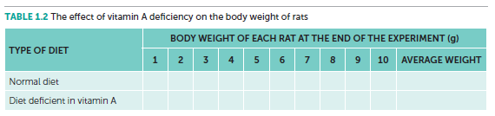
1.2 Scientific method
Presentation of data
In order to see any trend, the data needs to be presented in an organised manner.
Tables
A table is an organised and concise way of presenting data. Include an informative title, present the data in columns, and ensure each column has a heading that names the variable and the units in which it is measured.
For example, the results of the experiment on the effect of vitamin A on the growth of young rats is presented in the following table.

Slide 9
1.2 Scientific method
Graphs
A graph shows how changes in one variable affect a second variable.
When drawing a graph:
Include a title that summarises the relationship between the variables. This is usually written below the graph, as graphs are classified as figures.
Label the axes with the names of the variables.
Indicate the units in which each variable is measured.
Use a scale with equal intervals of units on each axis.

Slide 10
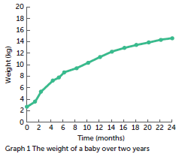
1.2 Scientific method
Line graphs are used when continuous data is being represented (e.g. length, mass, time, pH and volume).
When there is a trend between the variables, a line of best fit is drawn. This may be a straight line or a smooth curve.

Slide 11
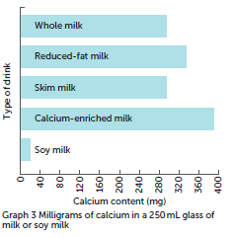
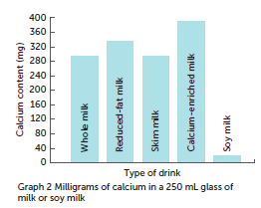
1.2 Scientific method
Bar or column graphs are used to graph discrete data. Data is represented by rectangles of equal width, with spaces between them. The length of each rectangle indicates the quantity, and so the various quantities can be compared easily.
Rectangles are drawn horizontally for a bar graph and vertically for a column graph.

Slide 12
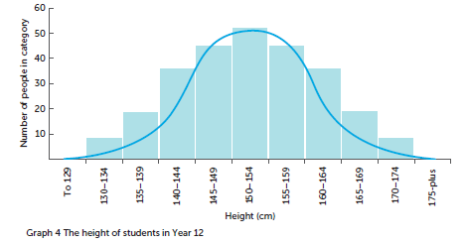
1.2 Scientific method
Histograms are often used to show frequencies, which is how often a particular value or characteristic occurs. They have columns to represent the frequency.
The columns are of equal width, but there is no space between them. Histograms are used particularly where the data has been grouped into categories to make it more manageable.

Slide 13
1.2 Scientific method
Interpreting the data
After all the data is collected, the scientist can make an interpretation of the results. Data from a well-designed experiment will either support or disprove the hypothesis. If the hypothesis is disproved, the scientist must make a new one or modify the original hypothesis. If the scientist concludes that the hypothesis is supported, they communicate the conclusion to others in a report with details of the experiments and the data collected.
Eventually, if enough supporting evidence is collected and there is no evidence against the hypothesis, then the hypothesis will become a theory.

Slide 14
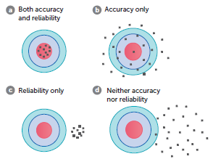
1.2 Scientific method
Evaluating the experiment
Scientists should reflect on the results and the method, in particular:
• The validity of the method, and therefore of the conclusion: a valid method will fairly test the hypothesis so that the only factor that affects the results is the independent variable.
• The accuracy of the results: this refers to how correct or true the measurements are.
• The reliability of the results: this refers to how similar the results for trials of the same test are. We are able to identify reliable results by conducting multiple trials and comparing the measurements

Slide 15
1.2 Scientific method
Experimental error
There are three possible types of error that may occur in an experiment:
• A human error is a mistake – e.g. incorrectly reading the scale on an instrument. Human errors are not part of experimental error. They should be avoidable with sufficient care and checking.
• Random errors are unpredictable errors that can occur in all experiments. They occur because no measurement can be made with absolute precision, e.g. when using a stopwatch. The impact of the error can be reduced by taking several measurements and averaging them.
• Systematic errors occur because of the way in which an experiment is designed or due to problems with equipment. In this case, a measurement will always be too high or too low. Systematic errors cannot be reduced by averaging; the only solution is to change the experimental procedure or equipment.

Slide 16
1.3 Investigating humans
Ethical problems
Ethics are a set of moral principles or values; ethical behaviour is behaviour that conforms to those principles or values. In scientific research, particularly with human participants, many ethical issues arise.
Five principles of an ethically sound investigation include:
Voluntary participation
Informed consent
Risk of harm (should be minimised and the benefit assessed)
Confidentiality
Anonymity

Slide 17
1.3 Investigating humans
Placebos
Placebos are used in research into the effectiveness of medical treatments, such as a new medicinal drug. In the case of a drug trial, a placebo is an inactive substance that looks like the real medication.
One group of subjects, the experimental group, takes the drug that is being tested and the other group, the control, takes the placebo.
Patients who are given a placebo often show an improvement in their condition even though the placebo is inactive, called the placebo effect.
To reduce this effect, researchers conduct blind experiments where the subjects do not know whether they are receiving the placebo or the treatment. In a double-blind experiment, neither the researcher nor the subjects know who is receiving the treatment or the placebo.

